Slide 1

Weather Conditions and Climate Change with ClimateWins
An Interim Report by Sreelaya Narla

Slide 2
Introduction
ClimateWins is investigating how machine learning can enhance climate forecasting and identify long-term environmental trends.
The goal is to analyze how data-driven models can help predict pleasant and unpleasant weather conditions across Europe.
By applying machine learning, we aim to uncover patterns, correlations, and indicators of climate change that traditional forecasting may overlook.

Slide 3

Objective & Hypotheses
Objective: Use machine learning to evaluate and predict weather conditions and potential climate change indicators across multiple European weather stations.
Hypotheses:
There is a correlation between rising temperatures and extreme weather events (e.g., heatwaves, heavy precipitation).
Prediction accuracy will vary depending on geographic location and climate characteristics.
No single machine learning algorithm will outperform all others for predicting weather patterns.

Slide 4

The Data
Source: European Climate Assessment & Dataset (ECA&D) project
Stations: 15–18 weather stations across Europe
Timeframe: Daily data from 1960 through 2022
Variables: Temperature, humidity, precipitation, wind speed, pressure, and cloud cover
Preprocessing: Missing data handled through interpolation and normalization for consistent scaling

Slide 5
Data Bias & Accuracy
Potential Biases:
Temporal Bias: Older records may reflect outdated or inconsistent measurement methods.
Historical Bias: Abundant older data may mask recent rapid climate shifts, reducing accuracy for current trends.
Selection Bias: More developed European regions are overrepresented, underrepresenting smaller or rural stations.
Accuracy:
Average model accuracy: 88% across stations.
Some stations (e.g., Sonnblick, Valentia) achieved over 95%, possibly due to stable climates or limited variability.
Consistently high accuracy across locations suggests strong model generalization, though isolated overfitting may occur.

Slide 6
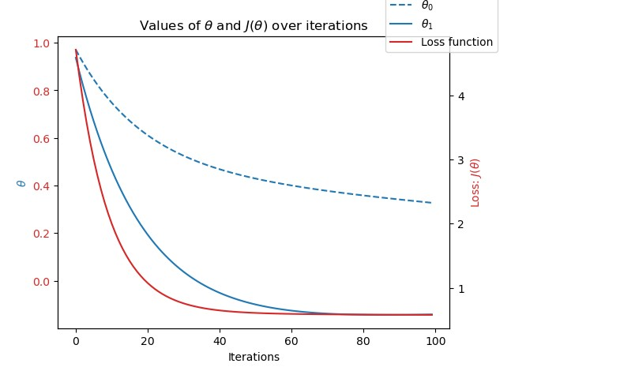
Optimization
Optimization Approach: Gradient Descent
The data was optimized using Gradient Descent, an iterative algorithm that adjusts parameters to minimize a loss function.
Gradient Descent continually updates model weights based on the direction of steepest error reduction, improving predictive accuracy with each iteration.
For this project, Gradient Descent was applied to optimize temperature and weather-condition prediction models across multiple European weather stations.
The iterative optimization minimized the loss function to nearly zero, suggesting that average temperature and weather conditions can be modeled by differentiable functions.
This process ensured the model converged toward optimal parameters and reduced overfitting, leading to consistent accuracy across most weather stations.

Slide 7
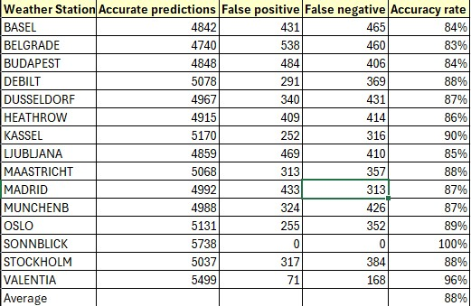
K-Nearest Neighbors
The K–Nearest Neighbors (KNN) algorithm predicts outcomes by measuring the distance between new data points and the nearest data points in the training set.
Each prediction is based on the majority class among its k closest neighbors—in this case, determining whether a day was pleasant or unpleasant.
KNN was applied to 15 European weather stations to predict pleasant weather days using a k-value of 3.
The model achieved an average accuracy of 88%, performing best in regions with stable climates.
Overfitting may have occurred at stations with limited variation or smaller datasets, where predictions reached 100% accuracy (e.g., Sonnblick).
To improve model generalization, future training should include more diverse regional data and account for seasonal variations.

Slide 8
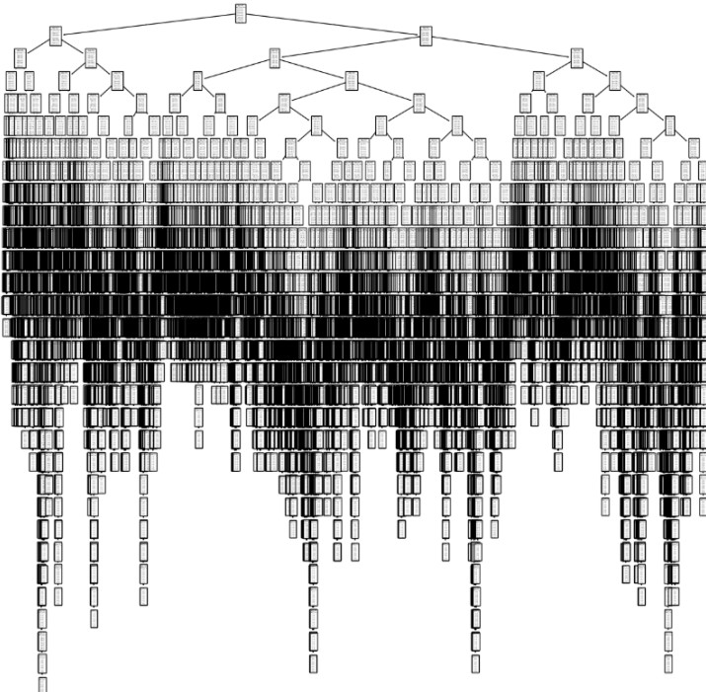
Decision Tree
The Decision Tree algorithm classifies data by asking a series of feature-based questions, splitting the dataset into branches until a decision (leaf) is reached — similar to a flow chart.
Each node represents a feature condition, and the path from root to leaf determines the predicted outcome, such as whether a day is pleasant or unpleasant.
The model was trained on data from 15 European weather stations to predict pleasant weather days.
The training accuracy was 46%, and the testing accuracy was 47%, indicating limited predictive power and potential overfitting due to excessive branching.
The tree’s complex structure makes it difficult to interpret and computationally heavy to train.
Pruning the tree or switching to ensemble methods (like Random Forest) could improve accuracy and prevent overfitting.

Slide 9
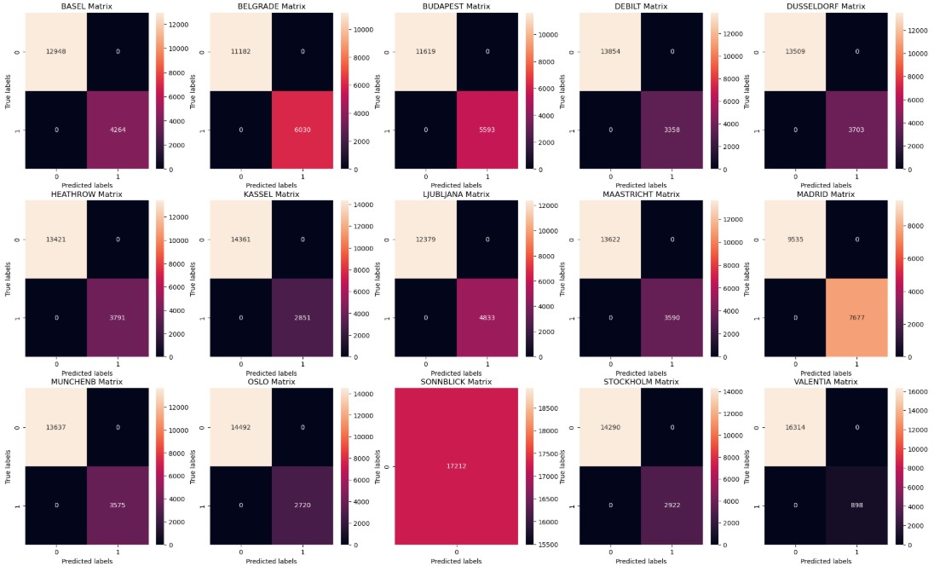
Artificial Neural Network (ANN)
The Artificial Neural Network (ANN) is inspired by the way the human brain processes information.
It consists of multiple layers of interconnected neurons that learn complex relationships between features through training.
Input layers receive data, hidden layers apply mathematical transformations, and the output layer produces the final prediction — in this case, whether a day was pleasant or unpleasant.
The ANN model was trained using data from 15 European weather stations, adjusting hidden layer size, number of iterations, and tolerance for optimal performance.
The model achieved a maximum testing accuracy of 56%, while training accuracy consistently remained higher, suggesting overfitting to the training data.
To improve performance, the model may require regularization techniques, additional data, or more balanced training samples across different weather stations.
Above is a series of confusion matrices. Each matrix represents accurate predictions of unpleasant days (upper left), inaccurate predictions of unpleasant days (upper right), inaccurate predictions of pleasant days (lower left), and accurate predictions of pleasant days (lower right). Each weather station has its own matrix. Notice Sonnblick’s solid matrix, which represents the ANN’s 100% accuracy in predicting only unpleasant weather days for this location.

Slide 10
Summary & Next Steps
Summary
Machine learning algorithms demonstrated strong potential in predicting future weather conditions, with some models achieving up to 88% accuracy.
Prediction accuracy varied depending on geographic location and local climate conditions — for example, Sonnblick achieved nearly 100% accuracy, while Madrid performed lower due to greater variability in weather.
The K-Nearest Neighbors (KNN) algorithm showed the highest and most consistent accuracy, making it the best current method for predicting pleasant and unpleasant weather conditions.
The Artificial Neural Network (ANN) algorithm can likely be improved through further tuning (adjusting hidden layers, learning rates, and iterations) to reach higher performance levels in future tests.
Machine learning overall can help identify climate change patterns by tracking extreme or unpleasant weather events over time.
Next Steps
Continue refining models to increase accuracy and reduce overfitting.
Further optimize the ANN model with hyperparameter tuning.
Explore unsupervised learning for hidden climate pattern detection.
Incorporate additional environmental variables (wind speed, humidity, etc.).
Use model insights to forecast long-term climate trends and guide climate policy and action.

Slide 11
Thank You!
Please
For questions and further discussion, please contact me at layanarla7@gmail.com Thank You!
Check out
Check out my GitHub (https://github.com/sreelayanarla) for the Jupyter notebooks behind this work as well as additional projects!
View
View my video presentation on vimeo!

